Slide 1
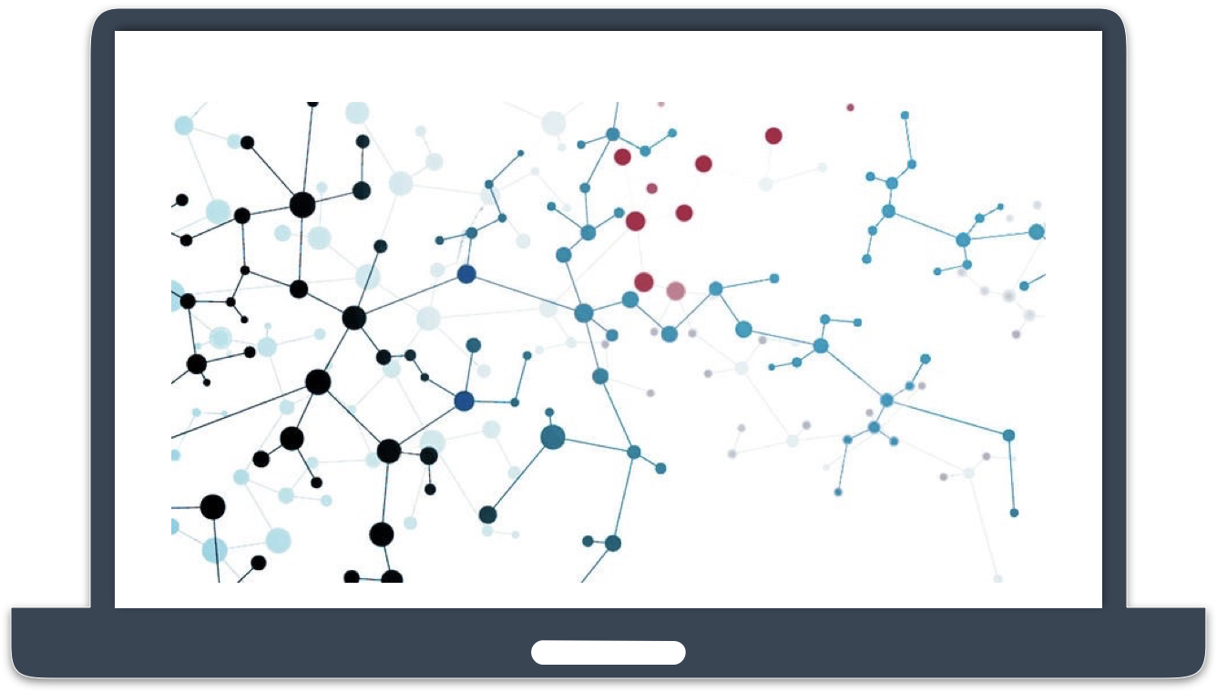


Python Tsunami Part 2:
Data Analysis in Python

Slide 2




Center for Health Data Science (HeaDS)
The mission of the Center is to strengthen
health data science within the Faculty:
Active and visible hub for Health Data Science
Providing data science support for researchers at SUND
Courses, workshops and training environments to improve data science skills
Support a network of researchers and educators
Notes:
Before starting the day, I would like to spend 2 minutes to introduce you to the Center for Health Data Science (HeaDS)

Slide 3

CENTER STRUCTURE
Generative modelling
Representation learning
Data Science in Epidemiology
HPC environments
Public & synthetic data
Courses and training
SANDBOX
RESEARCH GROUPS
SUND DATALAB
Courses, Consulting,
Commissions, Supervision

Slide 4
COURSE PROGRAM
Day 1
Day 2
Day 3
Coffee
09:00 Intro
09:15 Numpy and Pandas
11:00 Exploratory Data
Analysis
13:00 PCA
15:15 Objects, Classes and
Functions
09:00 Functions
10:30 Intro to Modelling:
Linear Regression
13:00 Linear Regression
15:30 Classification with
Decision Trees
09:00 Documentation and
Testing
09:50 K-means Clustering
11:10 Classes
13:00 Classes
14:00 Project work
Lunch

Slide 5





TEACHERS
Thilde Bagger Terkelsen
HeaDS
Helene Wegener
HeaDS
Inigo Prada- Luengo
Genomic Medicine (Righospitalet) and HeaDS
Henrike Zschach
HeaDS
Astrid Filt
BMI

Slide 6
WHAT IS DATA SCIENCE?
Data Science combines math, statistics, programming and algorithms with domain expertise in order to extract insights from data.
- IBM
Data Science is the processing of data with the goal to learn something about its characteristics or answer a scientific question.
- HeaDS

Slide 7

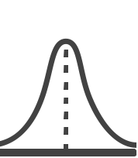
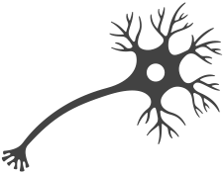
WHAT IS DATA SCIENCE?
PROGRAMMING
A cross-disciplinary undertaking that draws on many disciplines and is in turn becoming part of many disciplines.
Data matters, one size analysis does not fit all.
ML/AI
DATA
SCIENCE
MATH & STATISTICS
DOMAIN KNOWLEDGE

Slide 8
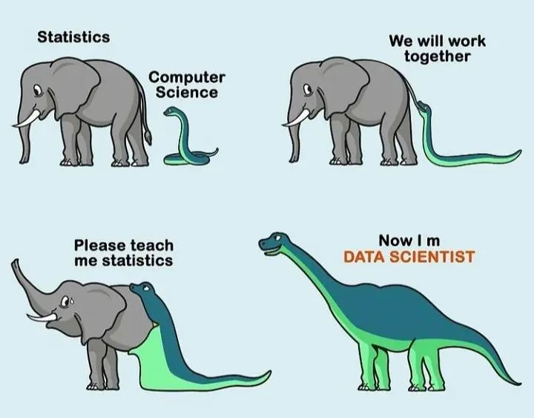
WHAT IS DATA SCIENCE?
PROGRAMMING
ML/AI
DATA
SCIENCE
MATH & STATISTICS
DOMAIN KNOWLEDGE

Slide 9
WHAT IS DATA SCIENCE?
PROGRAMMING
ML/AI
DATA
SCIENCE
MATH & STATISTICS
DOMAIN KNOWLEDGE

Slide 10


THE DATA’S JOURNEY
EXPLORATORY DATA ANALYSIS
DATA COLLECTION
MODELLING
MODEL EVALUATION

Slide 11






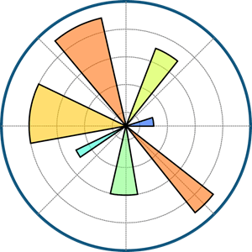

BUT FIRST …
We need some foundations in python to be able to start looking at these things.

Slide 12
DATA WRANGLING PACKAGES
These packages help us to:
Represent data in python objects (array and dataframe)
Load and save data
Manipulate data
Investigate data
Make summaries of data

Slide 13
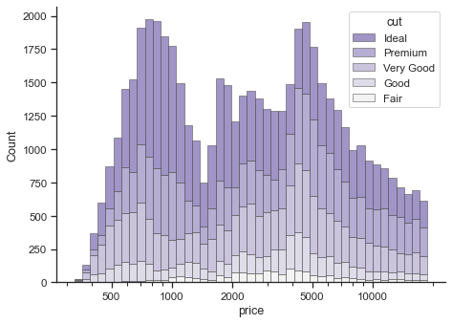
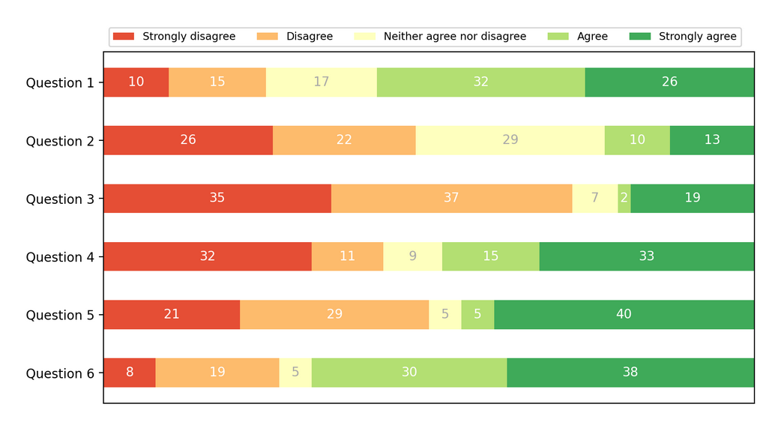
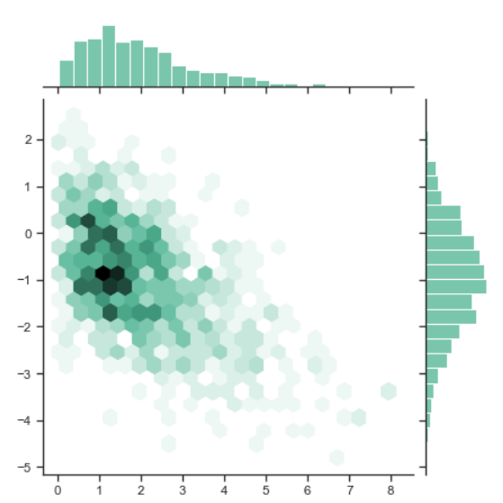
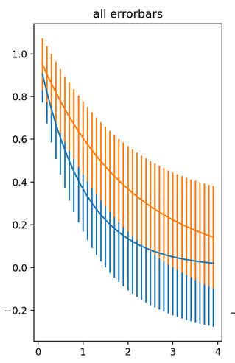
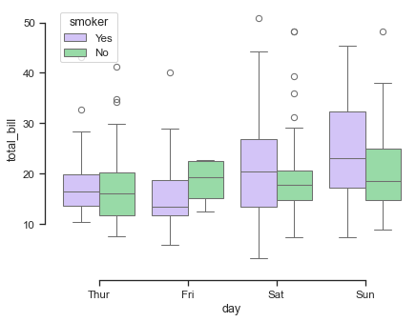
PLOTTING PACKAGES
These packages help us to visualize data:

Slide 14
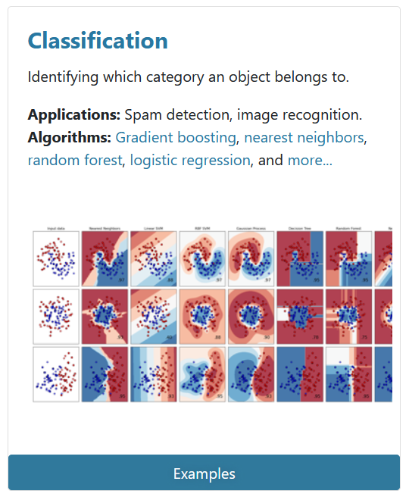
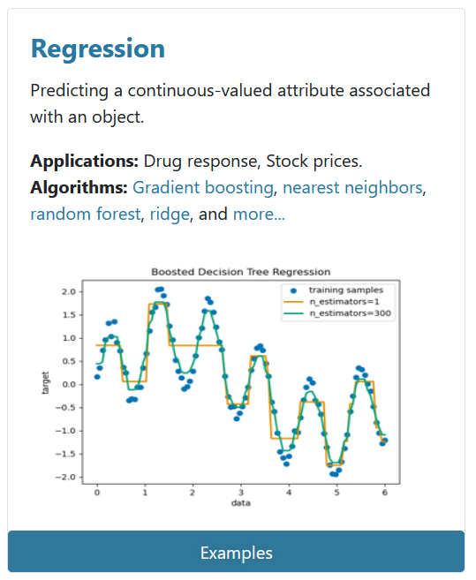
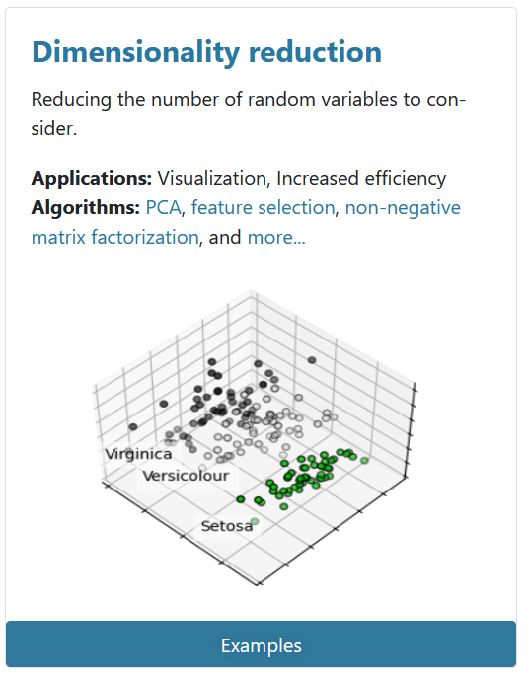
DATA SCIENCE PACKAGE
This package helps us to run data science algorithms.

Slide 15

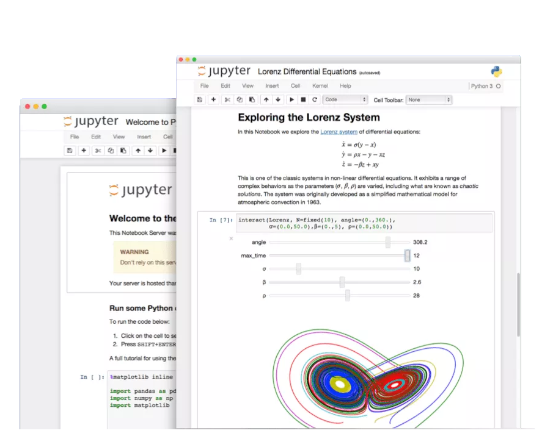
RUNNING PYTHON
The Jupyter Notebook:
Open source
Browser-based development environment for creating, running and sharing Python code
Combine code with text and output
Runs from your local installation. I.e., you need Python and the libraries you want to use installed on your computer

Slide 16

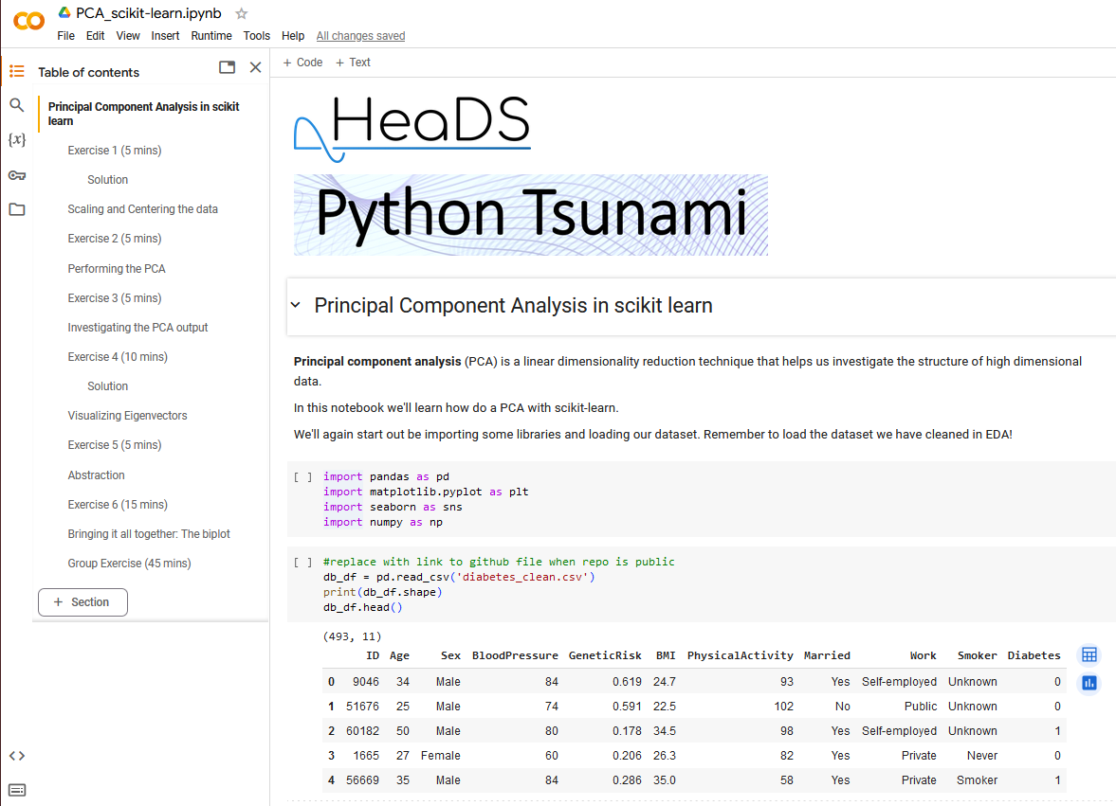
RUNNING PYTHON
Google Colab
a Jupyter Notebook executed on Google’s servers, not your own machine
Still browser-based
requires no setup to use and provides free access to computing resources on Google’s servers including GPUs
is connected to a Google account and data and notebooks can be accessed through Google Drive

Slide 17
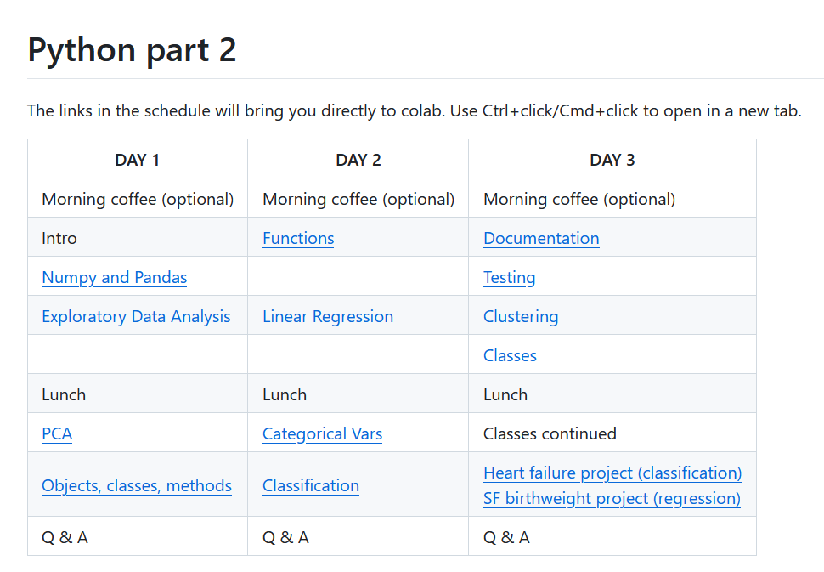
ACCESSING COURSE MATERIALS
We will be accessing the notebooks for this course via GitHub.
You can clone the repo and run the notebooks locally or open them in colab via the links in the schedule.

Slide 18
Numpy and Pandas Notebooks

Slide 19
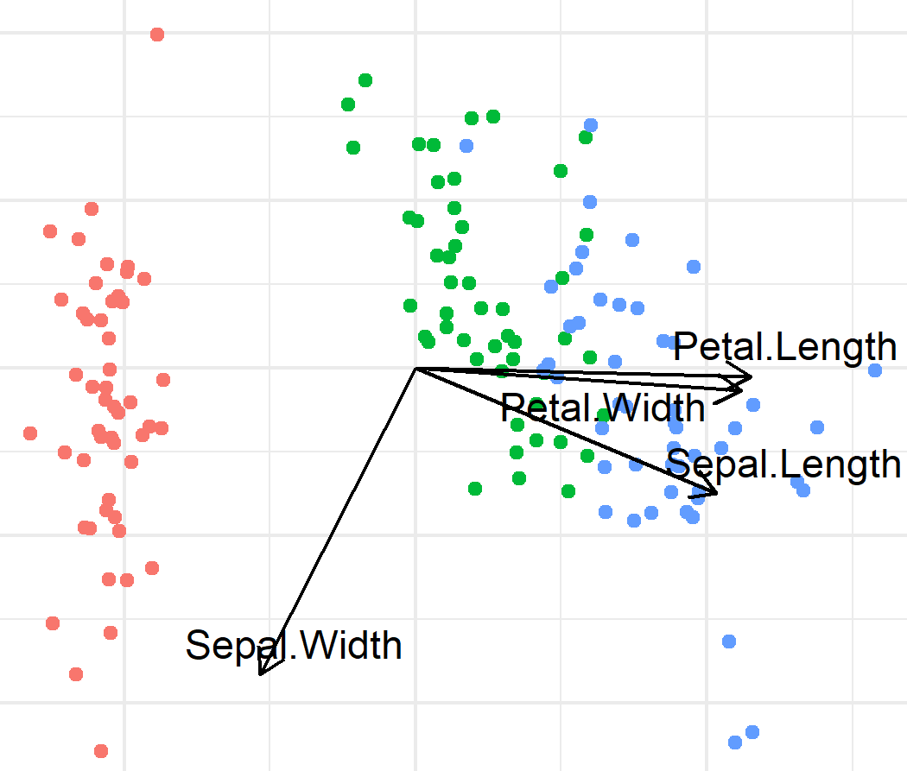
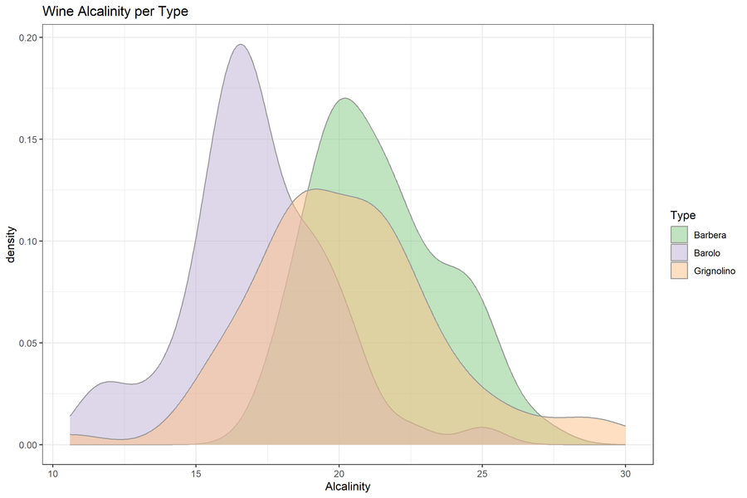
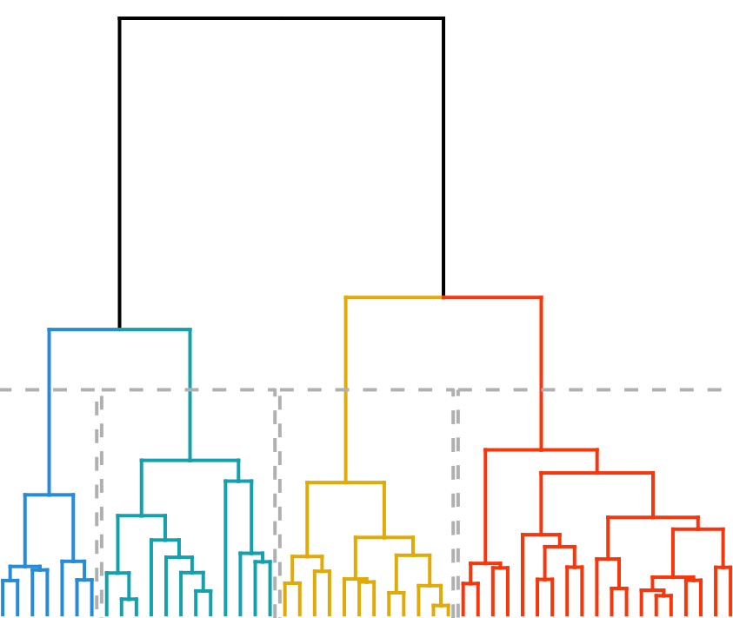
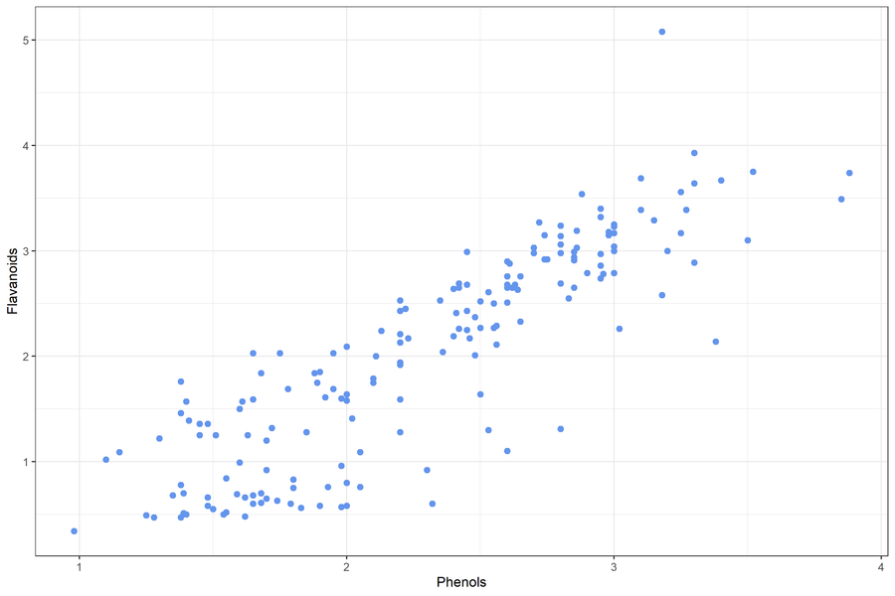
EXPLORATORY DATA ANALYSIS
Biplot
Before we can start modelling we need to familiarize ourselves with the data.
What data do we have?
Does it look as you expected?
Key characteristics
What kind of analysis can we do?
How do we need to prepare the data for analysis?
Density Plot
Dendrogram
Scatter Plot
Notes:
Need to check both your own data and data you find somewhere else (repositories,ect)
It’s important to find good data
Examples of ‘bad’ stuff:
Linear regression on 3 data points
T-test on 5 data points
Confirm that data is suitable for planned analysis
Or
Help with idea generation(patterns, relationships between variables)
Establish whether:
Data looks as expected
identify obvious errors: outliers, label swaps
Something needs to be corrected
Preparation method
(normalization is needed?)
Are there patterns between variables?
What is the relationship between variables
How do we need to prepare the data for analysis?
What kind of analysis can we do?
https://www.ibm.com/topics/exploratory-data-analysis
Originally developed by American mathematician John Tukey in the 1970s, EDA techniques continue to be a widely used method in the data discovery process today.

Slide 20
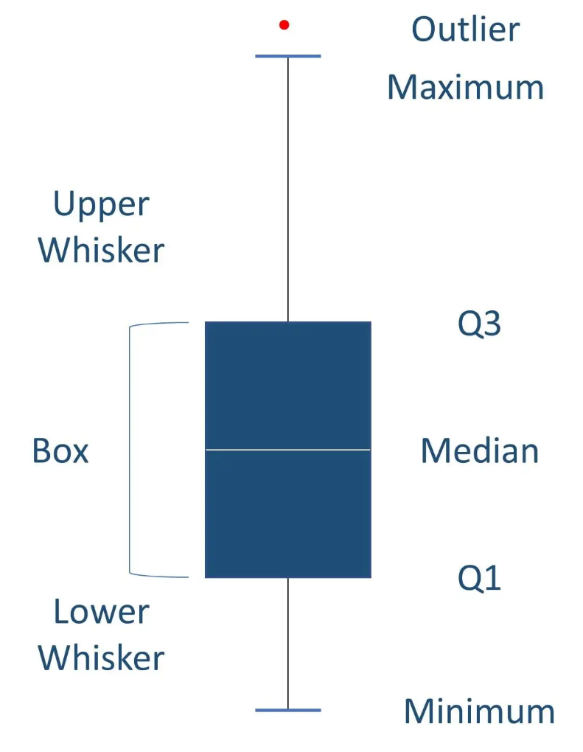
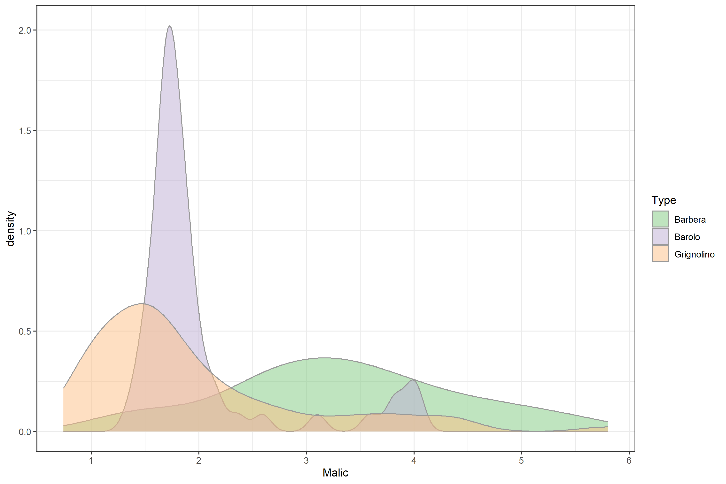
SUMMARY STATISTICS
Summary statistics are used to distill a dataset into some key characteristics.
They often include the following measures:
Central tendency (mean, median, mode)
Spread (standard deviation)
Minimum and Maximum
Quartiles
Shape of the distribution
Correlation between features
Notes:
Scales
Some features more predictive than others
Technical variables to be removed/included
Missing values

Slide 21

DATA CLEANING AND SET-UP
Wide w. missing values
We want to clean up our data:
Remove data outliers or duplicates
Ensure categorical variables are spelled the same
Change one type of variable to another type
Merge, add or remove variables
Layout, long VS wide format
Treatment | Age | height | weight
A | 55.0 | NA | 65.7
B | 31.0 | 172.0 | 69.4
C | 39.0 | 161.0 | NA
Imputation
Treatment | Age | height | weight
A | 55.0 | 170.0 | 65.7
B | 31.0 | 172.0 | 69.4
C | 39.0 | 161.0 | 58.1
Wide to long
Treatment | variable | value
A | Age | 55.0
A | height | 170.0
A | weight | 65.7
B | Age | 31.0
B | height | 172.0
B | weight | 69.4
C | Age | 39.0
C | height | 161.0
C | weight | 58.1
Missing values:
Filter out some/all missing values
Impute missing values (Regression, Maximum Likelihood, ML)
Notes:
Types of variables: factors, binary, characters, numerical, integers

Slide 22
MATPLOTLIB
The seaborn package is built on top of matplotlib, which is the original plotting library of python.
Advantages
you can control every aspect of the plot
Drawbacks
Granular syntax
Need to define everything yourself
Inconsistencies in functions and options between plot types
Seaborn is an interface to matplotlib which circumvents many of these problems but at the cost of being less customizable.
Notes:
Types of variables: factors, binary, characters, numerical, integers

Slide 23
EDA Notebook

Slide 24
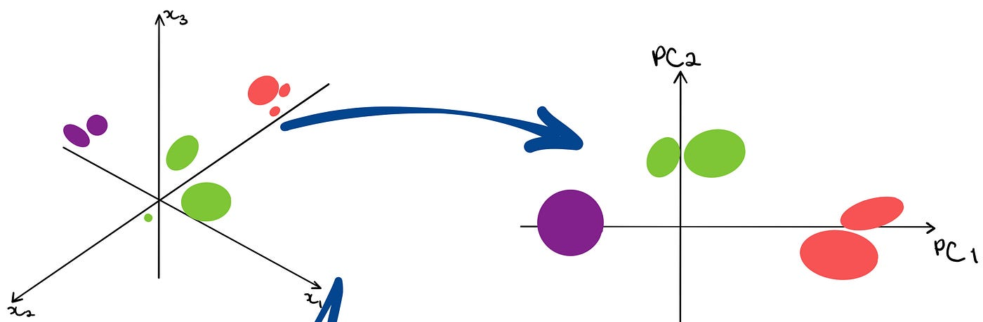
DOES THE DATA LOOK AS EXPECTED?
Single variables may be checked by their distribution, (density plot) but what about high-dimensional data?
One way to inspect the structure of your data is with a Principal Component Analysis (PCA) Plot
Image by Trist’n Joseph
PCA is a dimensionality reduction technique. It linearly transforms data from the original high dimensional space into a low (2 or 3) dimensional space, which the human eye can view and interpret.

Slide 25

PRINCIPAL COMPONENT ANALYSIS
Collection of wine bottles as an example. We have measured 13 different features such as alcohol content, color, alkalinity, and flavonoids.
PCA lets us derive a set of new dimensions that best describe all the original wine features while also being much lower dimensional.
These derived dimensions are the principal components and they will help us understand the structure of our data.
Notes:
PCs are linear combinations of all original features. Every original feature contributes to every PC (though some more than others)

Slide 26
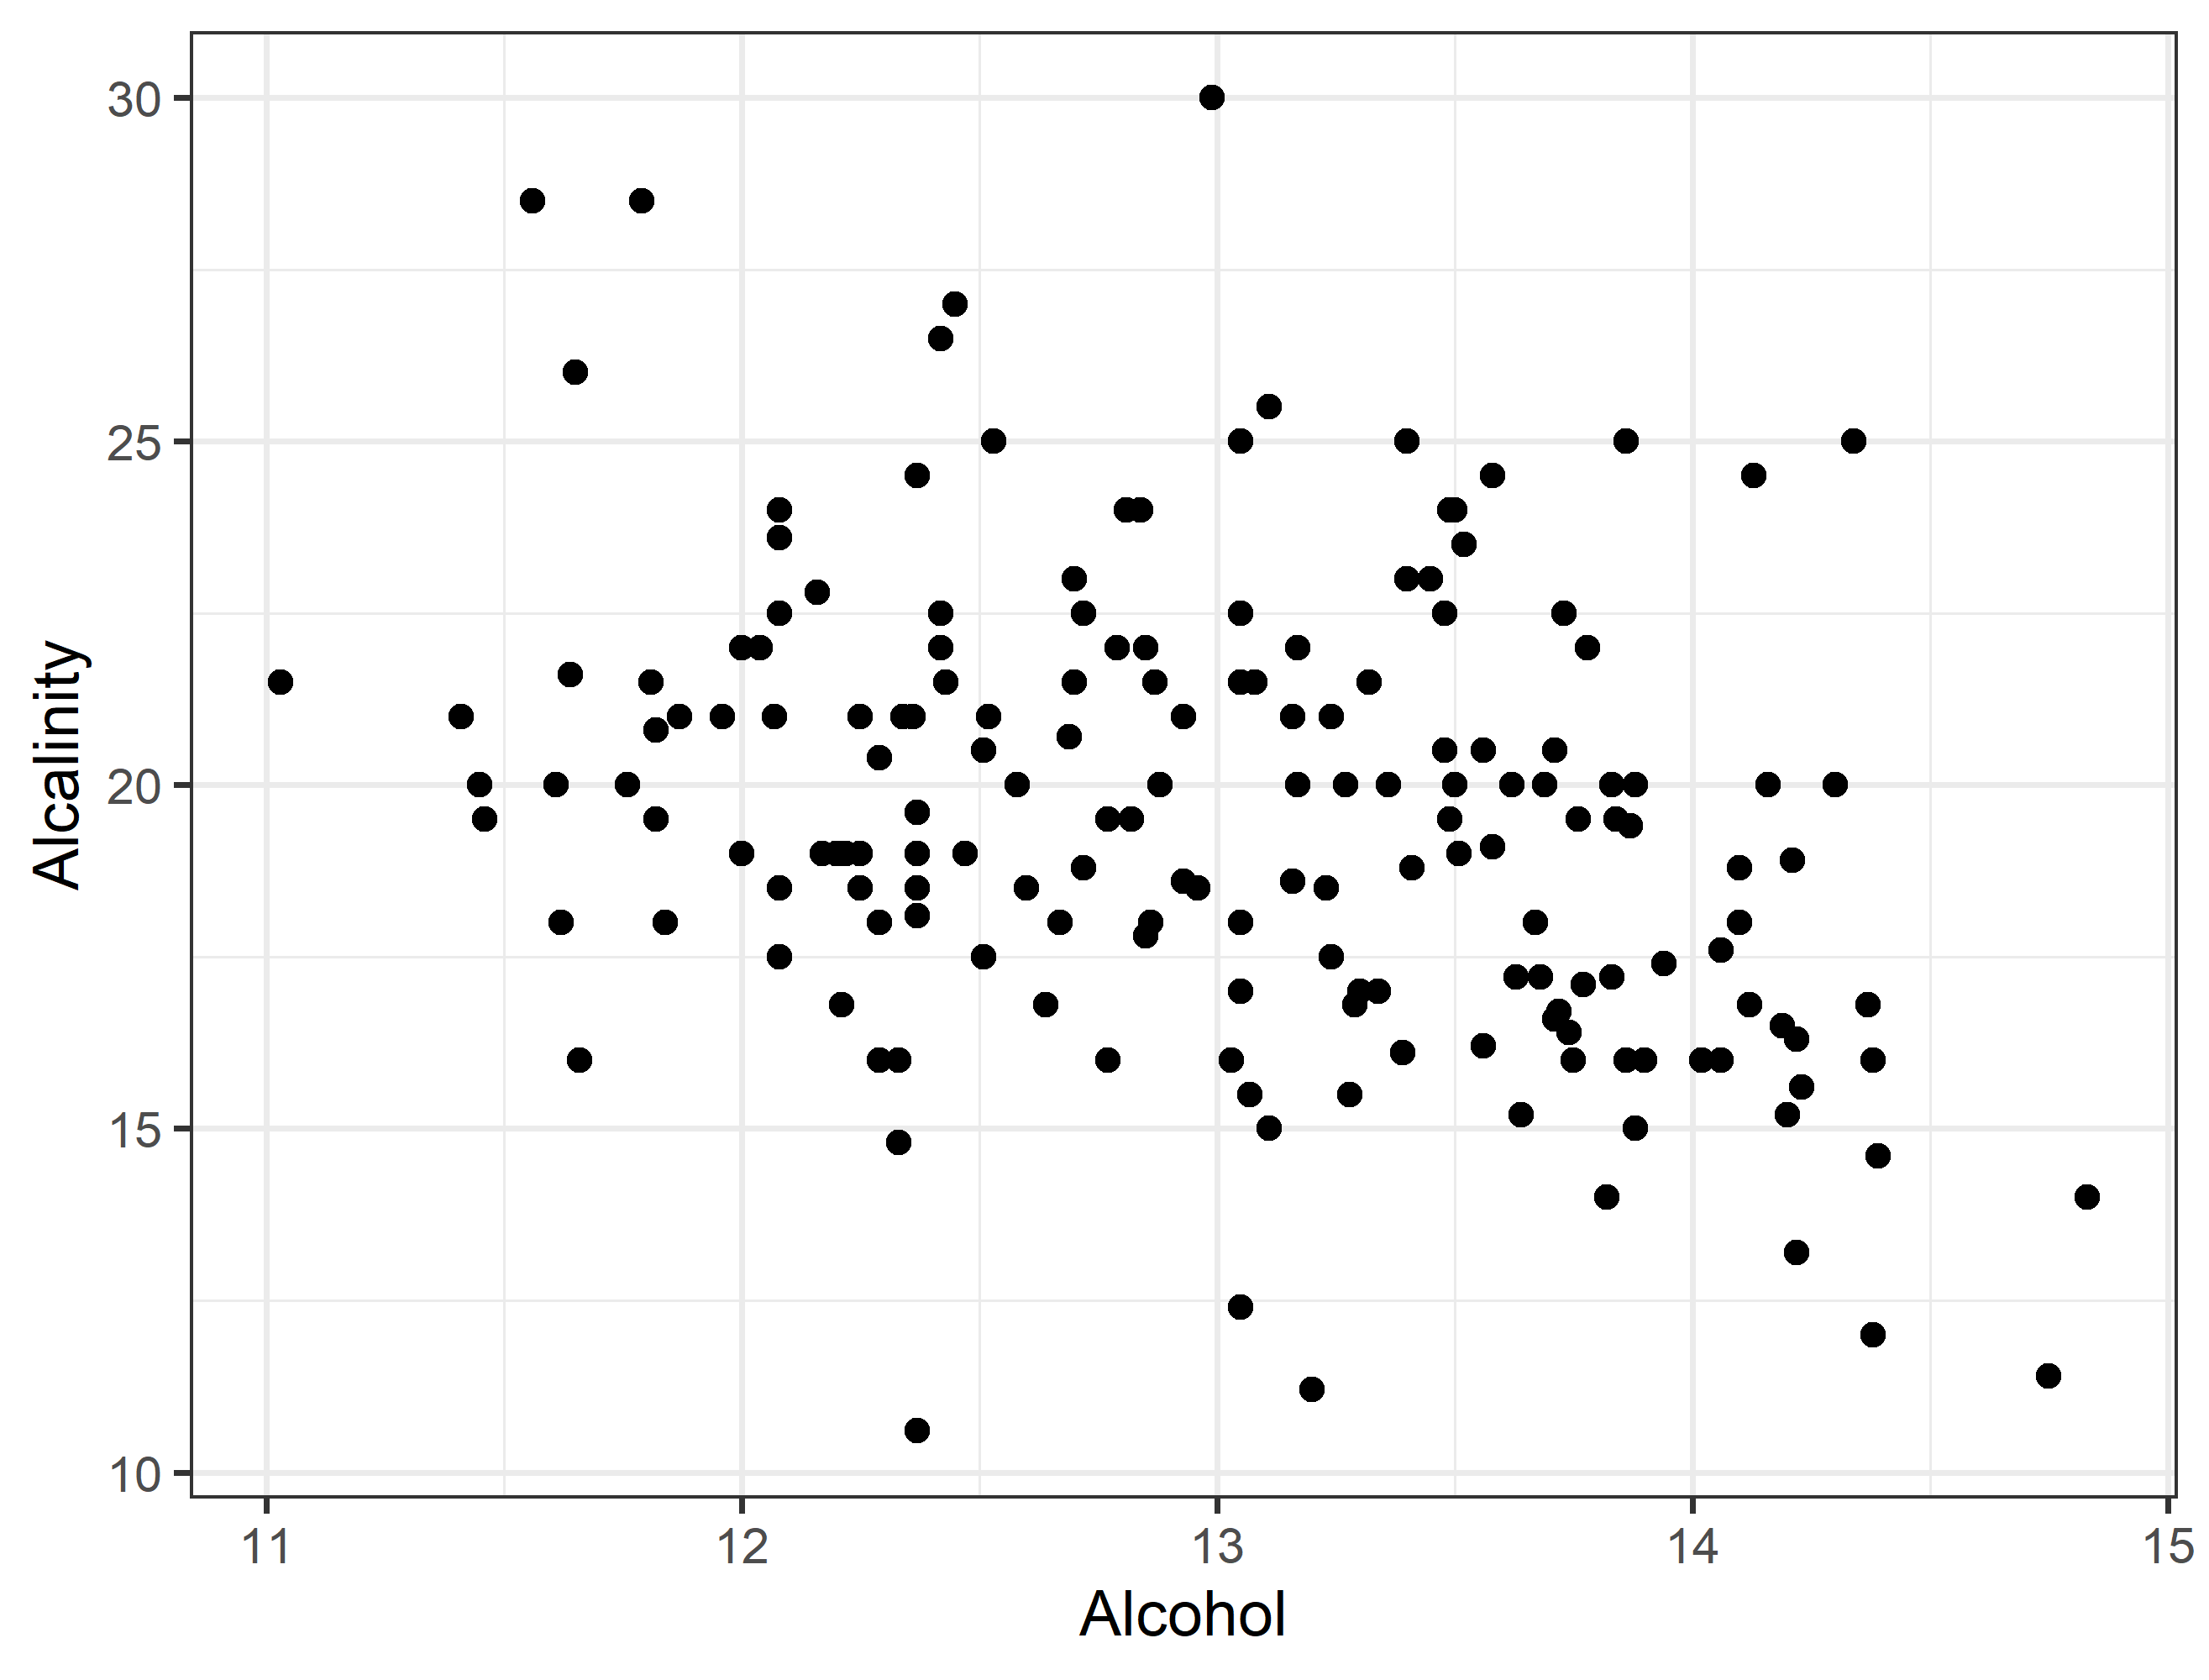
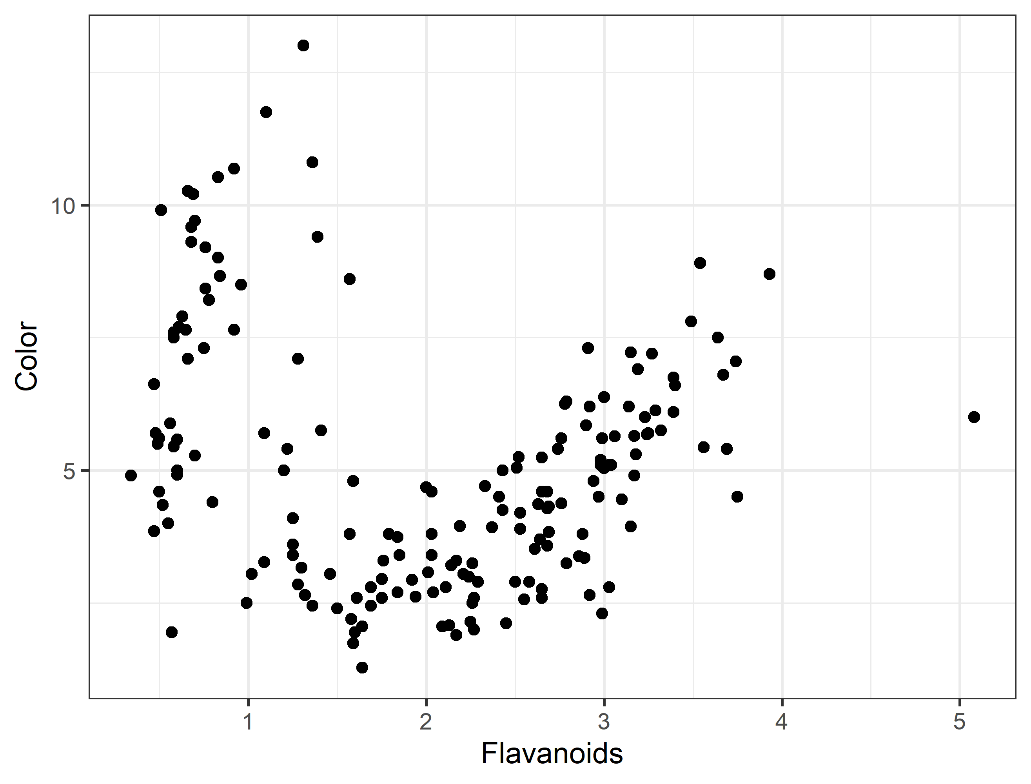
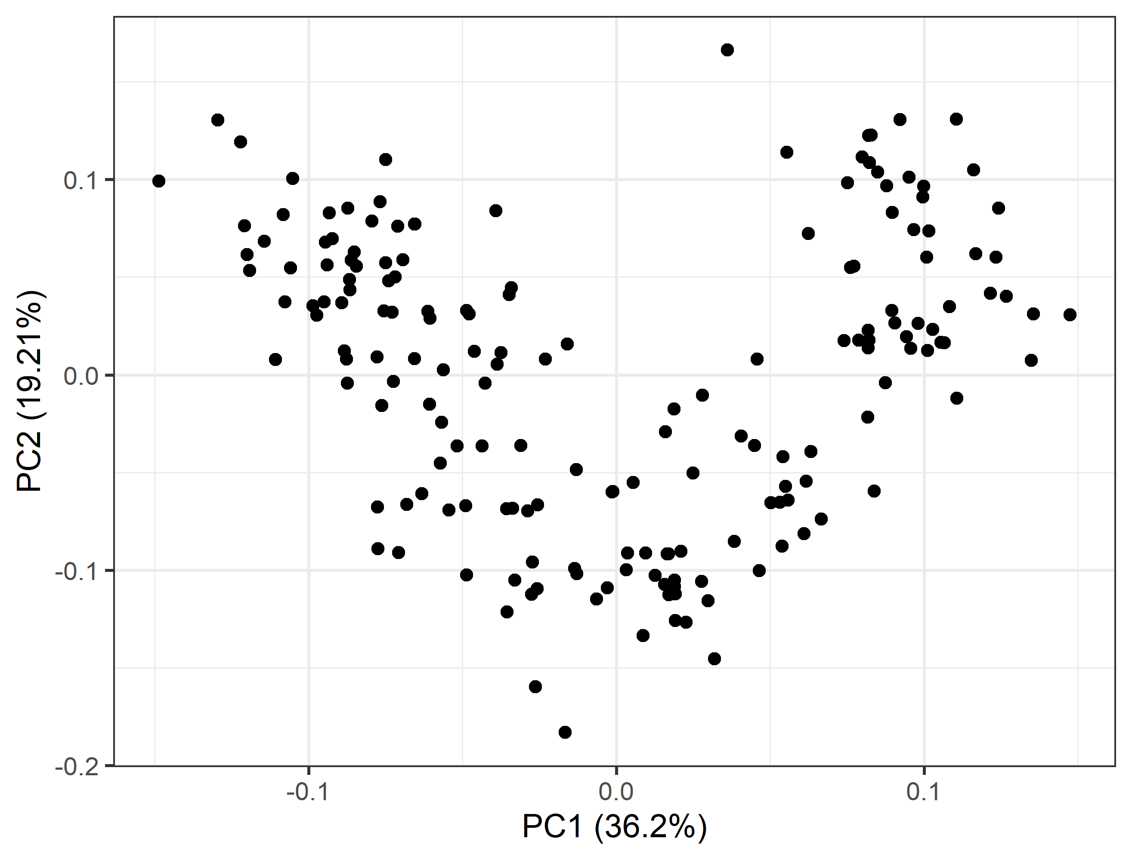
WHAT HAPPENS DURING PCA?
Original data with n = 13 dimensions
Mapped into PCA space with 2-4 dimensions
Wine type | Alc | Alkalinity | Flavonoids | Color | …
Barolo | 14.38 | 12.0 | 3.64 | 5.4 | …
Barolo | 12.93 | 18.0 | 2.41 | 4.5 | …
Grignolino | 11.66 | 16.0 | 1.57 | 3.8 | …
… | … | … | … | … | …
Wine type | PC1 | PC2 | PC3 | PC4
Barolo | -3.3 | 1.4 | -0.2 | 0.2
Barolo | -2.2 | -0.3 | -2.0 | 0.3
Grignolino | 1.5 | -1.4 | -0.8 | 2.8
… | … | … | … | …
Notes:
PCs are linear combinations of all original features. Every original feature contributes to every PC (though some more than others)

Slide 27
PRINCIPAL COMPONENT ANALYSIS
We can now plot all wine bottles in our data by the values of their first two PCs:
Each dot is one wine bottle.
If two wines are close in their PC1 and PC2, they are similar in the original feature space.
This helps us to visually understand the structure of our data (we cannot plot in 13 dimensions!).

Slide 28
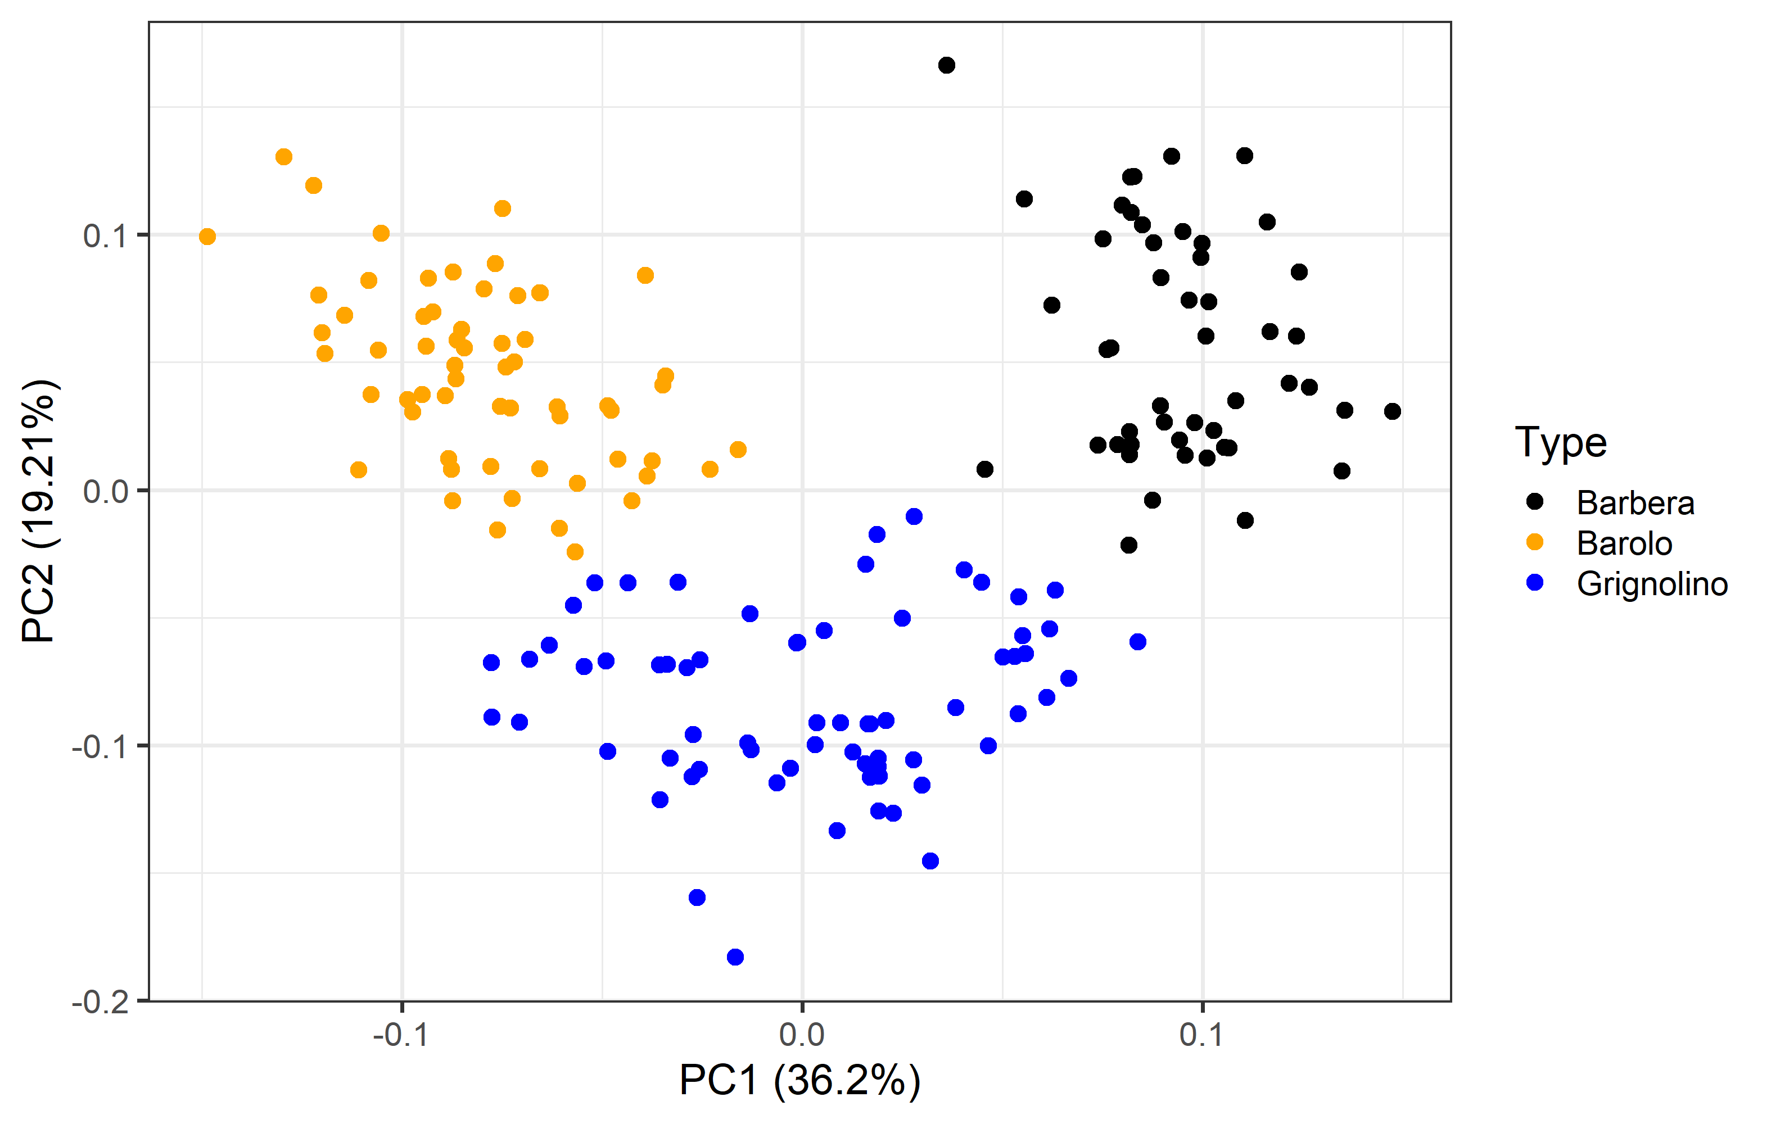
PRINCIPAL COMPONENT ANALYSIS
If two wines are close in PC1 and PC2 value they are similar also in their original features.
Color by wine type
Types of wine cluster together
Most Barbera wines are similar to other Barbera wines even in only 2 dimensions.
Notes:
Importantly, there are no 2 original dimensions (i.e. alcohol and color) we could have picked that would give us the same level of separation!
Now, what do you think would happen if we have an outlier data point with very strange values?
-> point somewhere by itself
What would happen if someone has swapped the labels of the type of wine?
-> you will see the dot in the cluster of another color

Slide 29
PRINCIPAL COMPONENT ANALYSIS
PC’s are linear combinations of the original features
If two clusters are well separated in the PCA that means there is a combination of original features that explains which cluster a data point belongs to.
We can use this to predict the cluster for new data points.
Notes:
Importantly, there are no 2 original dimensions (i.e. alcohol and color) we could have picked that would give us the same level of separation!
This bodes well if wanted to predict the type of wine from the original features since the principal components are linear combinations of the original features.
Mention what the explained variance means (percentage on the axis)
Importantly, there are no 2 original dimensions (i.e. alcohol and color) we could have picked that would give us the same level of separation!
Now, what do you think would happen if we have an outlier data point with very strange values?
-> point somewhere by itself
What would happen if someone has swapped the labels of the type of wine?
-> you will see the dot in the cluster of another color

Slide 30
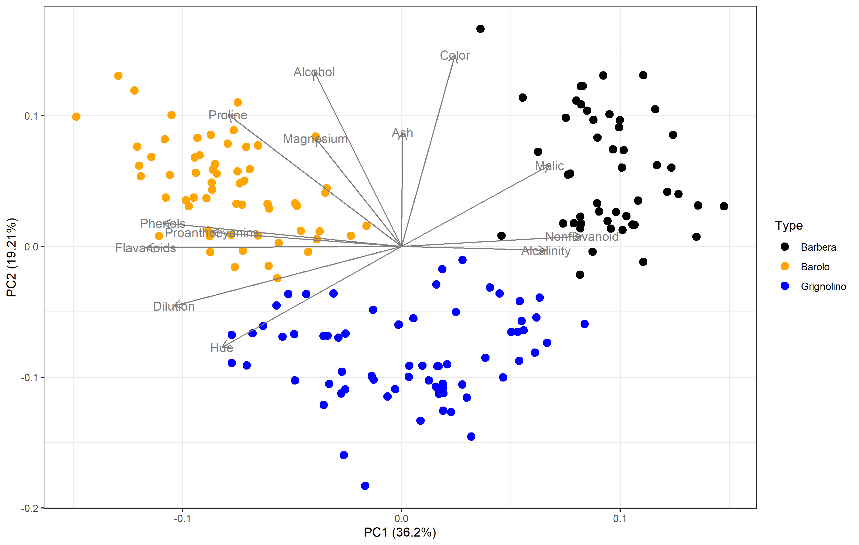
PRINCIPAL COMPONENT ANALYSIS
Coloring by wine type reveals clusters!
If clusters are well separated there is a combination of original features that explains which cluster a data point belongs to.
We can use this to understand what defines each cluster and predict which cluster a new data point belongs to.
Notes:
Importantly, there are no 2 original dimensions (i.e. alcohol and color) we could have picked that would give us the same level of separation!
Now, what do you think would happen if we have an outlier data point with very strange values?
-> point somewhere by itself
What would happen if someone has swapped the labels of the type of wine?
-> you will see the dot in the cluster of another color

Slide 31
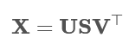
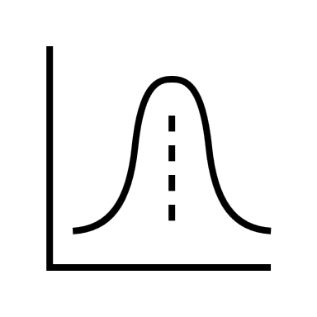
WHAT HAPPENS DURING PCA?
Formally PCA is a singular value decomposition such that:
Data projected into the PC space
- the scale
4 PCs x 13 features
Original data,
Scaled and centered
}
PC | Alc | Alkalinity | Flavonoids | Color | …
PC1 | -0.14 | 0.24 | -0.42 | 0.08 | …
PC2 | 0.48 | -0.01 | 0.01 | 0.53 | …
PC3 | -0.21 | 0.61 | 0.15 | -0.14 | …
PC4 | 0.02 | -0.06 | -0.15 | -0.07 | …
Eigenvectors
(weights)
- the direction
178 wines x 13 features
Alc | Alkalinity | Flavonoids | Color | …
1.51 | -1.17 | 1.03 | 0.25 | …
0.25 | -2.48 | 0.73 | -0.29 | …
1.50 | -0.96 | 0.97 | 0.57 | …
… | … | … | … | …
178 wines x 4 PCs
PC1 | PC2 | PC3 | PC4
-3.3 | 1.4 | -0.2 | 0.2
-2.2 | -0.3 | -2.0 | 0.3
1.5 | -1.4 | -0.8 | 2.8
… | … | … | …
These are the dots in a PCA plot.
X̄
0
0
sd = 1
Notes:
U – PCs scaled to unit norm. Shape is n*n
S – Singular values (can get Eigenvalues from this). Shape is n * m
V^T - Eigenvectors

Slide 32
WHAT HAPPENS DURING PCA?
Every PC is a linear combination of all original dimensions:
PC1 value for bottle 1
Alcohol value
for bottle 1
Alkalinity value
for bottle 1
Flavonoid value
for bottle 1
Color value
for bottle 1
…
Eigenvector of
PC1 in Alcohol
Eigenvector of
PC1 in Alkalinity
Eigenvector of
PC1 in Flavonoids
Eigenvector of
PC1 in Color
Scaled and centered data
4 PCs x 13 features
Alc | Alkalinity | Flavonoids | Color | …
1.51 | -1.17 | 1.03 | 0.25 | …
0.25 | -2.48 | 0.73 | -0.29 | …
1.50 | -0.96 | 0.97 | 0.57 | …
… | … | … | … | …
PC | Alc | Alkalinity | Flavonoids | Color | …
PC1 | -0.14 | 0.24 | -0.42 | 0.08 | …
PC2 | 0.48 | -0.01 | 0.01 | 0.53 | …
PC3 | -0.21 | 0.61 | 0.15 | -0.14 | …
PC4 | 0.02 | -0.06 | -0.15 | -0.07 | …
Notes:
PCs are linear combinations of all original features. Every original feature contributes to every PC (though some more than others)

Slide 33
PRINCIPAL COMPONENT ANALYSIS
We can also project the Eigenvectors into the plane of the PCs.
This helps us to visually interpret how each of the original dimensions contributes to each PC.
Transposed Eigenvectors:
PC | Alc | Alkalinity | Flavonoids | Color | …
PC1 | -0.14 | 0.24 | -0.42 | 0.08 | …
PC2 | 0.48 | -0.01 | 0.01 | 0.53 | …
PC3 | -0.21 | 0.61 | 0.15 | -0.14 | …
PC4 | 0.02 | -0.06 | -0.15 | -0.07 | …
Notes:
Importantly, there are no 2 original dimensions (i.e. alcohol and color) we could have picked that would give us the same level of separation!
This bodes well if wanted to predict the type of wine from the original features since the principal components are linear combinations of the original features.
Mention what the explained variance means (percentage on the axis)
Importantly, there are no 2 original dimensions (i.e. alcohol and color) we could have picked that would give us the same level of separation!
Now, what do you think would happen if we have an outlier data point with very strange values?
-> point somewhere by itself
What would happen if someone has swapped the labels of the type of wine?
-> you will see the dot in the cluster of another color

Slide 34
PCA Notebook

Slide 35

Objects, classes and methods

Slide 36
Day 2

Slide 37

Functions

Slide 38
WHERE WE LEFT OFF
EXPLORATORY DATA ANALYSIS
DATA COLLECTION
MODELLING
MODEL EVALUATION

Slide 39
DATA ANALYSIS
The outcome is known
The outcome is unknown
or there are no labels
Supervised Learning
Unsupervised Learning
Regression
Classification
Notes:
Scikit learns focus is on predictive performance (on unseen data), not inference.
It is true that a mathematical models can help weigh the explanatory power but only if you conduct on F-test on the coefficient value
Since sci-kit learn is apparently not a stats package and not meant for inference https://stackoverflow.com/questions/26319259/how-to-get-a-regression-summary-in-scikit-learn-like-r-does lets not get into the weeds with this.

Slide 40
MODELLING
We are specifically interested in a mathematical model that describes the relationship between predictors/features x_{i} and the outcome y. This helps us to:
Quantify the predictive power of x over y
Qualify the relationship (is it linear, ect)
Predict new y's from known values of x_{i}
Notes:
Scikit learns focus is on predictive performance (on unseen data), not inference.
It is true that a mathematical models can help weigh the explanatory power but only if you conduct on F-test on the coefficient value
Since sci-kit learn is apparently not a stats package and not meant for inference https://stackoverflow.com/questions/26319259/how-to-get-a-regression-summary-in-scikit-learn-like-r-does lets not get into the weeds with this.

Slide 41
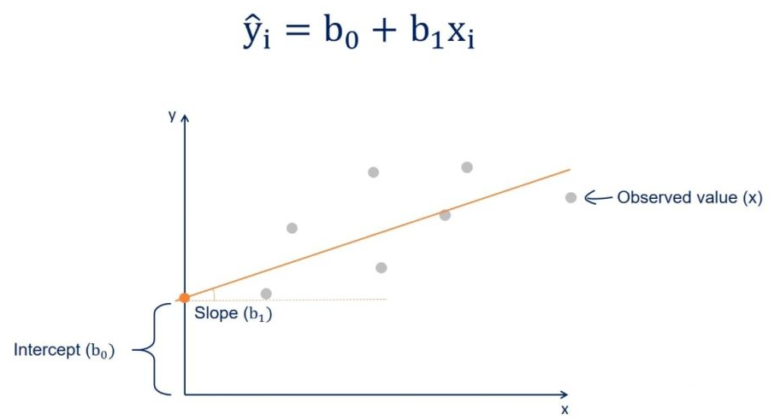
MODELLING - REGRESSION
Pick a model
Fit the model parameters to our data
Evaluate model performance
Interpret model parameters
HYPOTHESIS TESTING
Exam score
Hours studied
Notes:
The generalization is generalized linear models where you can have a non-linear link function (but you don’t have to, linear regression is also a glm) and non normally distributed residuals
Glms are more flexible, they relax some of the assumptions that must be true for linear regression
Log regression is also a glm.

Slide 42
MODELLING - REGRESSION
1. Pick a model
Linear Regression:
The exam score (y) can be approximated as a base value (intercept b₀) + the hours studied (x) * a coefficient (slope b₁).
HYPOTHESIS TESTING
Exam score
Hours studied
Notes:
The generalization is generalized linear models where you can have a non-linear link function (but you don’t have to, linear regression is also a glm) and non normally distributed residuals
Glms are more flexible, they relax some of the assumptions that must be true for linear regression
Log regression is also a glm.

Slide 43
MODELLING - REGRESSION
2. Fit the model
HYPOTHESIS TESTING
predicted ŷ
Our hypothesis is that
ŷ = b₀ + b₁ * x
where ŷ is the predicted outcome.
We want to find b₀ and b₁ such that ŷ is as similar as possible to y. b₀ and b₁ are also referred to as the model's trainable parameters.
Exam score
Hours studied
Notes:
The generalization is generalized linear models where you can have a non-linear link function (but you don’t have to, linear regression is also a glm) and non normally distributed residuals
Glms are more flexible, they relax some of the assumptions that must be true for linear regression
Log regression is also a glm.

Slide 44
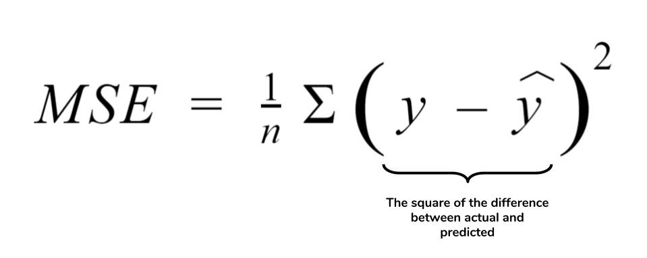
MODELLING - REGRESSION
3. Evaluate model performance
HYPOTHESIS TESTING
Now that we have a model with fitted parameters we need to quantify the discrepancy between ŷ and y. This will be our model performance.
Exam score
Hours studied
Notes:
The generalization is generalized linear models where you can have a non-linear link function (but you don’t have to, linear regression is also a glm) and non normally distributed residuals
Glms are more flexible, they relax some of the assumptions that must be true for linear regression
Log regression is also a glm.

Slide 45
TRAIN AND TEST DATA
In order to have a fair evaluation of model performance, we only use part of the data for training (fitting) and reserve another (small) part to test performance.
Data
Test
Cross Validation
Test
Train
Test
Test
Notes:
When we do CV we make as many models as there are folds. We may then combine them into an ensemble method.

Slide 46
MODELLING - REGRESSION
4. Interpret model parameters
HYPOTHESIS TESTING
predicted ŷ
Our linear regression model has this form:
ŷ = b₀ + b₁ * x
And we have estimated parameters b₀ and b₁. What do they mean?
b₀ – the predicted value of ŷ when x is 0
b₀ – the predicted change in ŷ for a one unit change in x
Exam score
Hours studied
Notes:
The generalization is generalized linear models where you can have a non-linear link function (but you don’t have to, linear regression is also a glm) and non normally distributed residuals
Glms are more flexible, they relax some of the assumptions that must be true for linear regression
Log regression is also a glm.

Slide 47
Linear regression
Life exp
?
Cigarettes

Slide 48
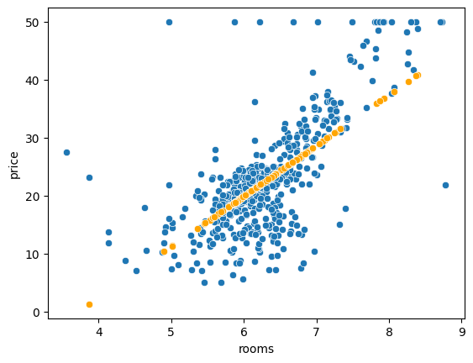
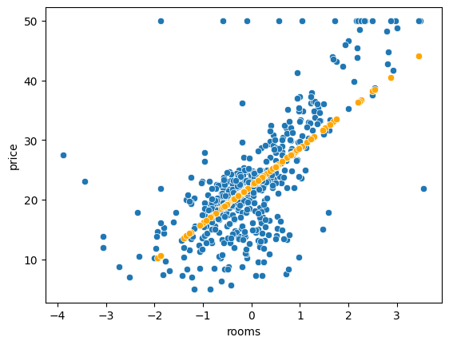
CENTERING PREDICTORS
The intercept is the outcome value we get when the predictors are at 0. But some predictors do not include 0 in their range so then the intercept doesn't make much sense.
Linear Regression Boston Housing
Fix:
Center the predictor.
X̄
0
Now the intercept is the outcome we expect when the predictor takes its mean value. This does not change the predictive performance!
Intercept: -32.4
Intercept: 22.4
Notes:
This does not affect model performance. We just get an interpretable intercept.

Slide 49
SCALING PREDICTORS
Another technique that is sometimes employed is scaling the predictors (features).
This means moving them from whichever scale they are on to a scale with a std dev of 1.
0
0
sd = 1
This also does not change the predictive performance! But it has implications for the interpretation:
ŷ = b₀ + b₁ * x₁ + b₂ * x₂
x₁ the number of cigarettes smoked
x₂ the number of minutes of exercise
ŷ the life expectancy
Size of product is
constrained
Change in life exp. estimate for each extra daily cigarette.
Change in life exp. estimate for each extra minute of exercise.
Notes:
This does not affect model performance. We just get an interpretable intercept.

Slide 50
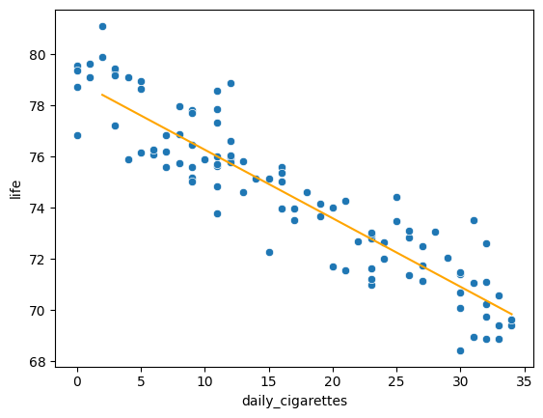
REGRESSION WITH CATEGORICALS
Our example model:
ŷ = b₀ + b₁ * x
With estimated parameters:
life ~ 78.4 + (-0.26) * daily cigarettes
This allows us to model the life expectancy as a base value (intercept) + the number of daily smoked cigarettes times a coefficient b₁. We can conceivably add other numerical predictors and estimate their coefficients.
But how can we incorporate categorical predictors?
Notes:
This does not affect model performance. We just get an interpretable intercept.

Slide 51
REGRESSION WITH CATEGORICALS
Let's say we have a binary predictor 'exercise' we can use a model of this form:
life = intercept + coef_c * daily_cigs + coef_e * exercise with exercise ∈ {0,1}
Or in more math terms:
ŷ = b₀ + b₁ * x₁ + b₂ * x₂
Since x₂ ∈ {0,1} we have only two cases:
ŷ = b₀ + b₁ * x₁ + b₂ * x₂ if x₂ == 1 (the person exercises)
ŷ = b₀ + b₁ * x₁ if x₂ == 0 (the person does not exercise)
For our example we therefore expect to find b₁ < 0 and b₂ > 0 and all is well.
Notes:
This does not affect model performance. We just get an interpretable intercept.

Slide 52
REGRESSION WITH CATEGORICALS
We now have 3 parameter estimates:
ŷ = b₀ + b₁ * x₁ + b₂ * x₂
How does exercising change our estimate of life exp. when number of cigarettes is constant?
Change in life exp. estimate for each extra daily cigarette.
The estimate of life expectancy at no cigarettes and no exercise.
Notes:
This does not affect model performance. We just get an interpretable intercept.

Slide 53
REGRESSION WITH CATEGORICALS
What happens if the predictor has more than two levels?
with exercise ∈ {0,1,2,3}
life = intercept + coef_c * daily_cigs + coef_e * exercise
We can still do:
ŷ = b₀ + b₁ * x₁ + b₂ * x₂
But mathematically we'll be saying:
There is no effect of doing level 0 == no exercise
A person who does level 1 exercise gains b₂ years of life expectancy
A person who does level 2 exercise gains double as much!
And at level 3 triple!
Levels coded
as integers
Notes:
This does not affect model performance. We just get an interpretable intercept.

Slide 54
REGRESSION WITH CATEGORICALS
Instead of integers we can use what is called dummy or one hot encoding:
ŷ = b₀ + b₁ * x₁ + b₂ * x₂ + b₃ * x₃
with exercise ∈ {0,1,2}
Now we can say:
If exercise == 0: x₂ = 0 & x₃ = 0
If exercise == 1: x₂ = 1 & x₃ = 0
If exercise == 2: x₂ = 0 & x₃ = 1
And we get:
b₂ is the gain in life exp at exercise level 1
b₃ is the gain at level 2
No assumption on relationship between b₂ and b₃, but 1 extra predictor so less power.
x₂ x₃
0 0
1 0
0 1
x₂, x₃ are indicator vars that say which level of exercise we are currently modelling.
We need one less indicator var == dummy than we have levels.

Slide 55
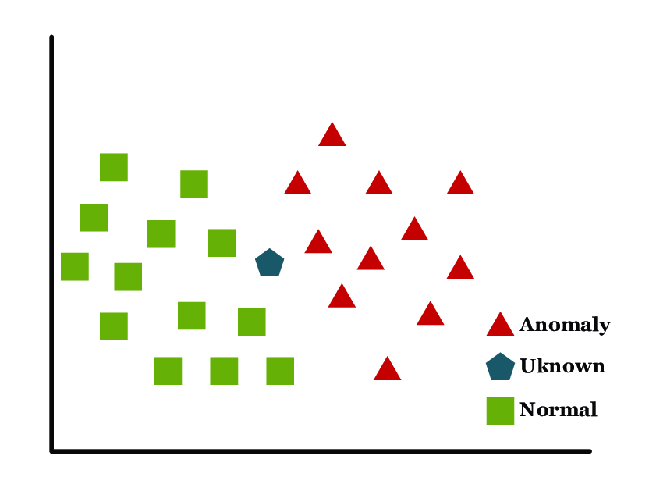
CLASSIFICATION
When the outcome variable is binary/categorical our goal becomes classification rather than regression:
Regression: Which value is a new y likely to take given we know x?
Classification: Which class is a new y likely to belong to given we know x?
HYPOTHESIS TESTING
predicted ŷ
Exam score
Hours studied
Group 1
?
Group 2
Notes:
The generalization is generalized linear models where you can have a non-linear link function (but you don’t have to, linear regression is also a glm) and non normally distributed residuals
Glms are more flexible, they relax some of the assumptions that must be true for linear regression
Log regression is also a glm.

Slide 56
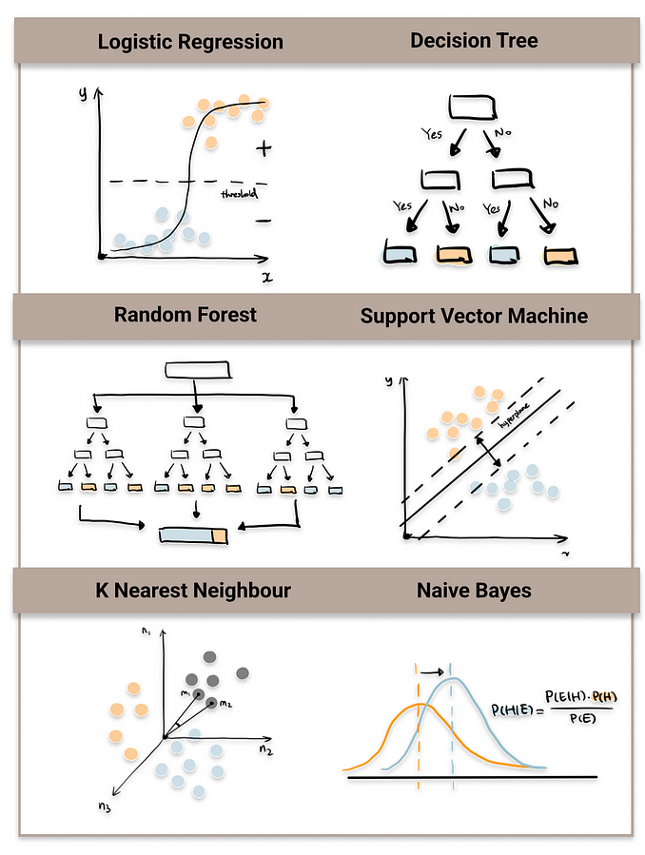
CLASSIFICATION MODELS
There are many algorithms that perform classification:
Logistic Regression
Naïve Bayes
Support Vector Machine
Random Forest
K-Nearest Neighbors
https://towardsdatascience.com/top-machine-learning-algorithms-for-classification-2197870ff501

Slide 57
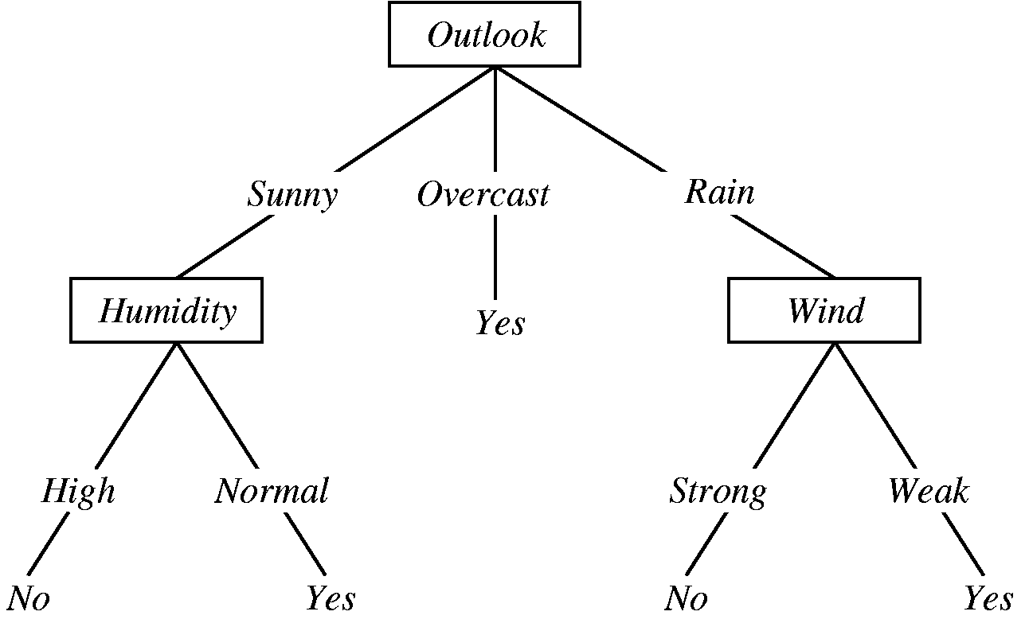
DECISION TREE
A decision tree is a series of 'checks' we follow to determine which class a data point belongs to. Each time a check is made, the dataset is split.
Will I bike to work today?
Root node
It has three different kinds of nodes:
Root node:
Contains all datapoints
The first check is made
Decision node
Decision node:
Subsequent checks
Leaf node:
Labeled with of the possible classes
Leaf node

Slide 58
DECISION TREE: TRAINABLE PARAMETERS
Just like a linear regression model we fit the decision tree to our data.
Will I bike to work today?
Hyperparameters:
Criterion to evaluate the goodness of the split
Number of leaf nodes
Minimum amount of samples in a leaf
Other parameters related to structure
Trainable parameters:
The structure of the tree
Feature importance
Notes:
Just like a linear regression model, the tree model also has trainable parameters

Slide 59
Decision Trees
Is it a holiday?
Should I eat cake?
Yes
No
Yes
Also yes
but in blue

Slide 60
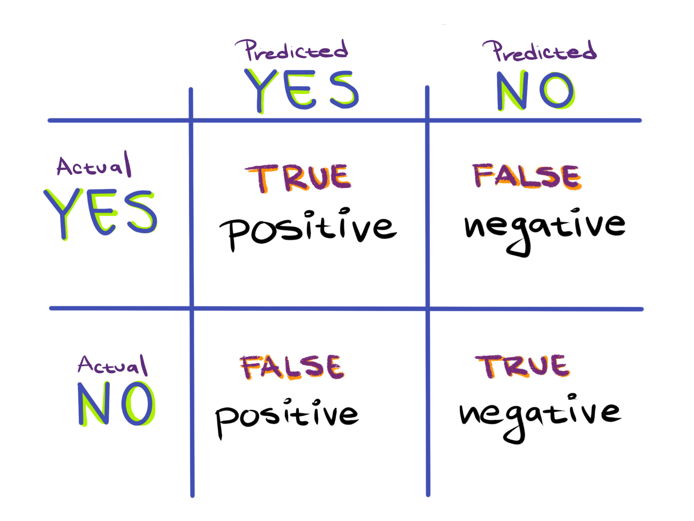
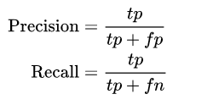
CLASSIFIER PERFORMANCE
For a classifier that output only labels, like a decision tree, we look at the numbers of True and False negatives and positives.
This is called a confusion matrix.
However …
Notes:
Every type of model has their own criteria by which we evaluate

Slide 61
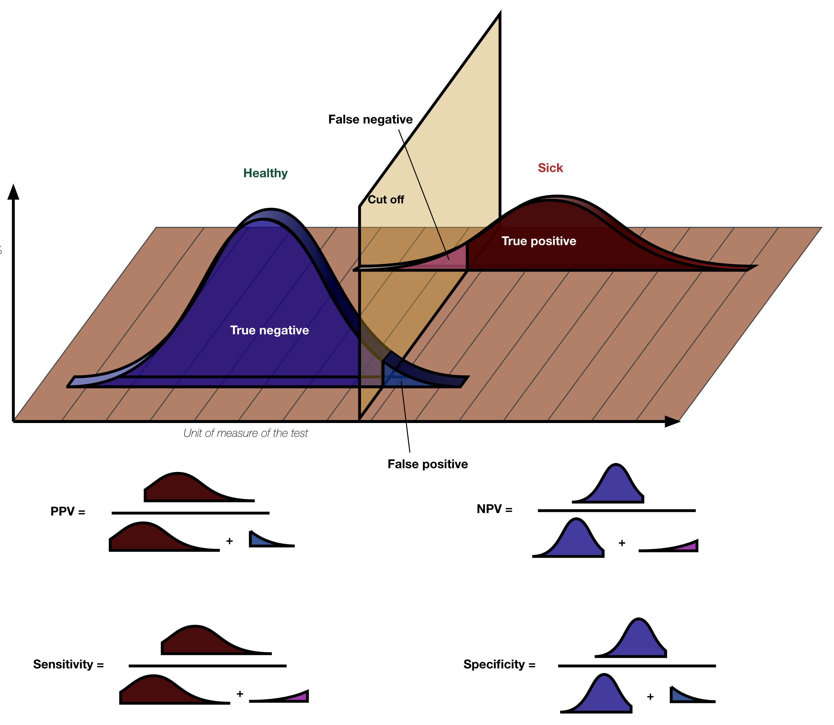
CLASSIFIER
PERFORMANCE
Most other classification models have a movable decision boundary:
One can easily optimize on the number of false positives or false negatives, but not both at the same time. For these types of classifiers we look at the area under the curve.
Precision :
Recall/
True positive rate
Notes:
This is true for classifiers that actually produce a score, like logistic regression and support vector machines. The simplest classifies would be a check on a single feature that has two different distributions in the two classes and we slide a decision boundary along it.
Precision == the ratio of true positive predictions to the total number of positive predictions made by the model.
Specificity == the ratio of true negative predictions to the total number of actual negative cases in the data.
Recall (sensitivity)== the ratio of true positive predictions to the total number of actual positive cases in the data.
Accuracy == the ratio of correctly predicted cases (both true positives and true negatives) to the total number of cases.
There is often a trade-off between precision and recall. Increasing one metric may lead to a decrease in the other. It depends on the specific threshold set for the model to classify predictions as positive or negative.
In the Context of Disease Diagnosis:
High precision is important when the consequences of a false positive prediction are significant, as it minimizes the chances of unnecessary treatments or interventions.
High recall is crucial when the consequences of a false negative prediction are severe, as it minimizes the chances of missing actual cases of the disease.
F1 Score: To balance precision and recall, the F1 score, which is the harmonic mean of precision and recall, is often used. F1=2×Precision×RecallPrecision + RecallF1=Precision + Recall2×Precision×Recall​

Slide 62
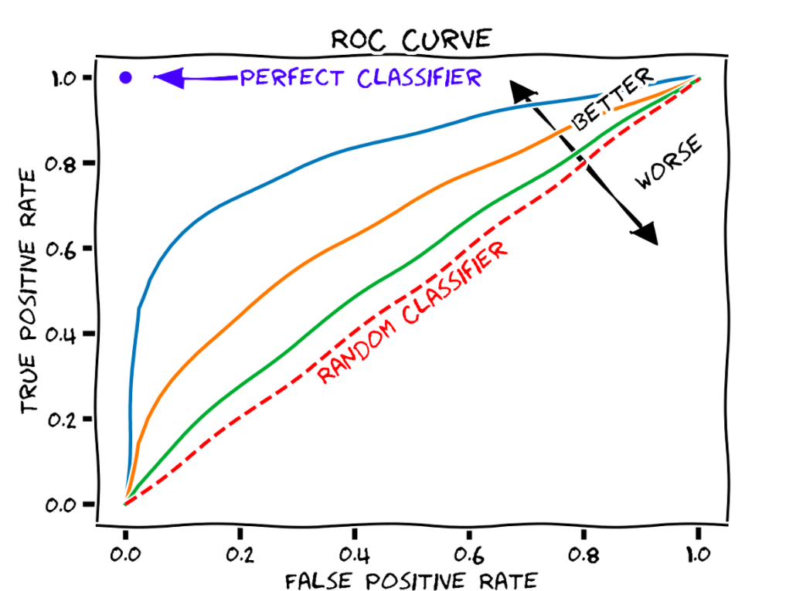
AREA UNDER THE CURVE (AUC)
How many of the true cases have we discovered?
Receiver Operator Curve (ROC)
Plotted by using every possible decision boundary.
Each True Positive Rate has an associated False Positive rate.
Notes:
True positive = sensitivity
False positive – 1-specificity(true negative)
In terms of classifiers we always have the trade-off between true-positive and false-positive rates:
If we want few false positives (people predicted to have cancer though they are healthy), we will also have more false negatives (cancer people predicted to be healthy)
If we want to miss as few cases as possible, we will have a high amount of false-positives.

Slide 63

OVERFITTING: CAPTURING NOISE
Data are inherently noisy because:
There is no perfect measurement
Individual differences
Random fluctuations
Under fit
Appropriate fit
Over fit
A model that follows the training data too closely generalizes poorly to new data (with different noise) and the trends and parameters it captures may not be meaningful.
Too simple to explain variance in the data
Parameters capture tendency in data
Too many parameters capture noise in data
Notes:
Just like a linear regression model, the tree model also has trainable parameters

Slide 64
CIRCLING BACK
EXPLORATORY DATA ANALYSIS
DATA COLLECTION
MODELLING
MODEL EVALUATION
Prep must fit to analysis!

Slide 65
Day 3

Slide 66
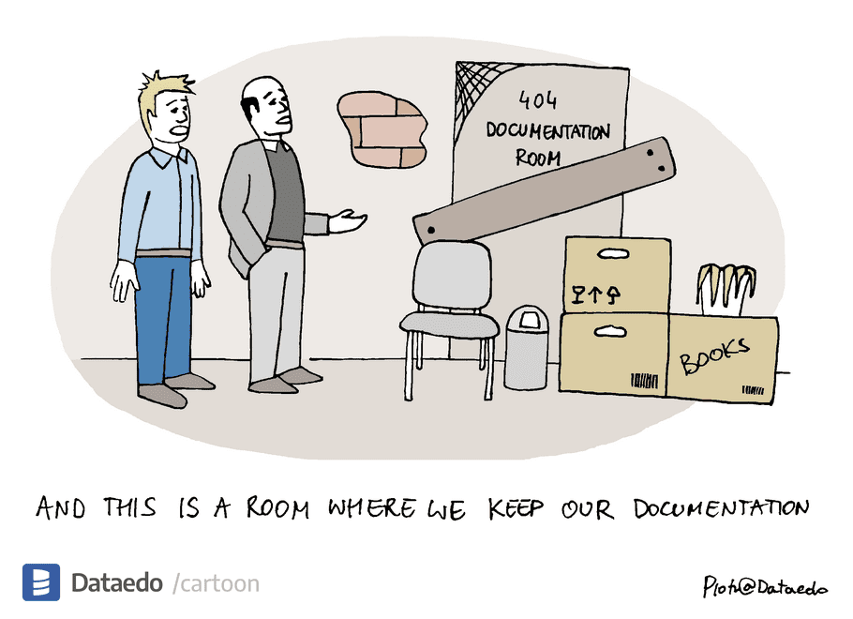
Documentation and Testing

Slide 67
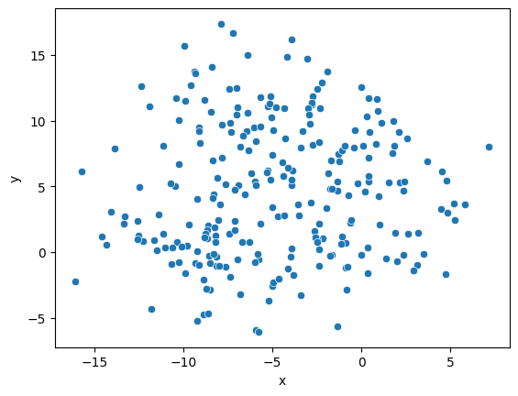
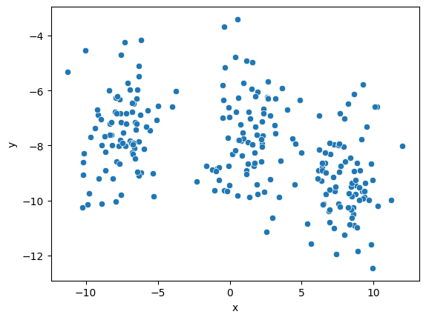
UNSUPERVISED LEARNING
What if we have data without labels? We can still do unsupervised learning to investigate questions such as:
Are there clusters, i.e. groupings, in this dataset?
What characterizes the members of a cluster?
Optimal number of clusters?
Which cluster does a new data point belong to?
We answer these questions with clustering techniques.

Slide 68
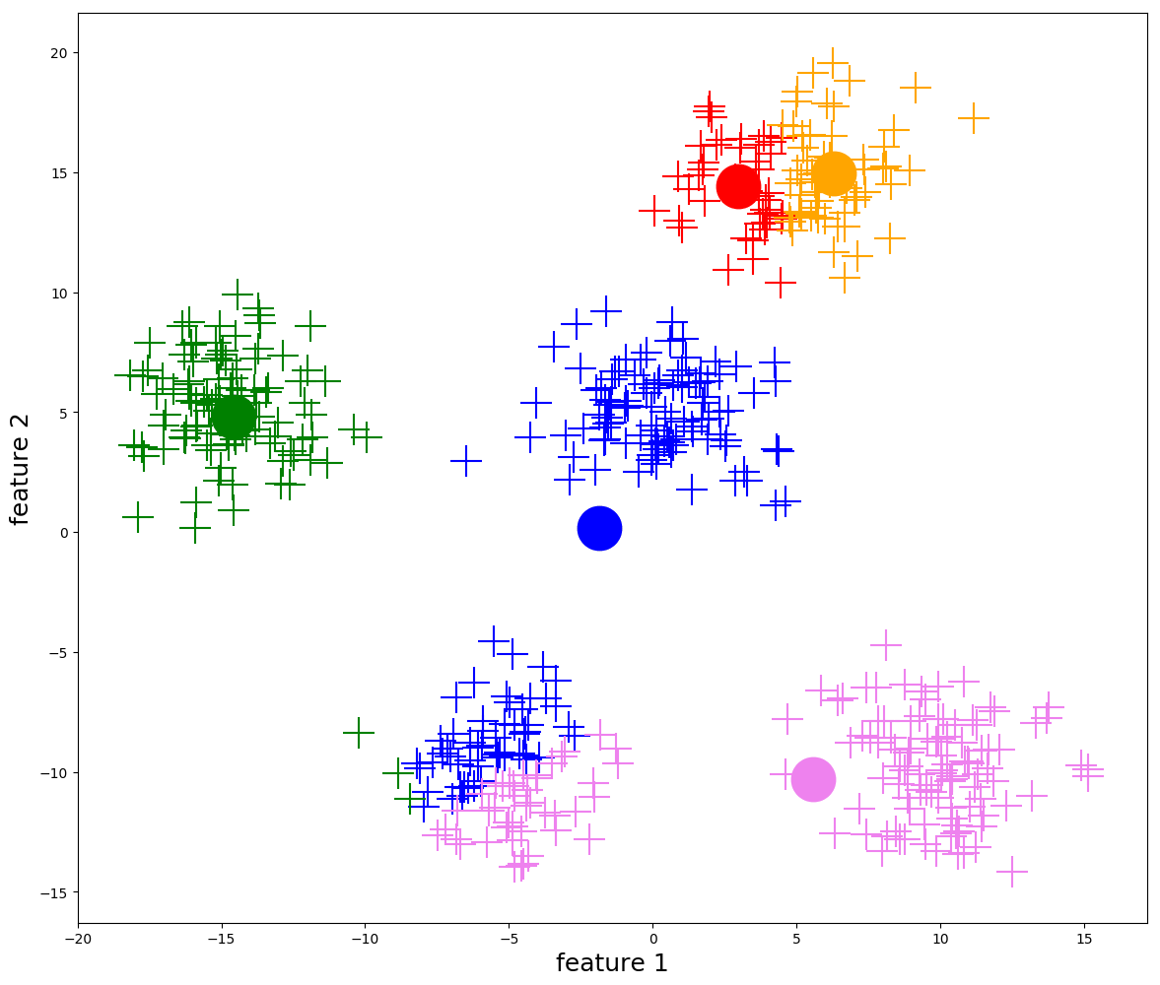
K-MEANS CLUSTERING
K-means clustering:
Choose number of clusters
Initialize centroids
Assign each data point to the closest centroid
Recalculate centroids based on all data points that are part of the current cluster

Slide 69
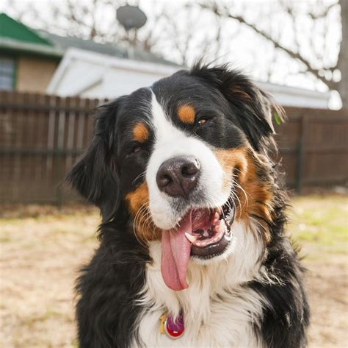




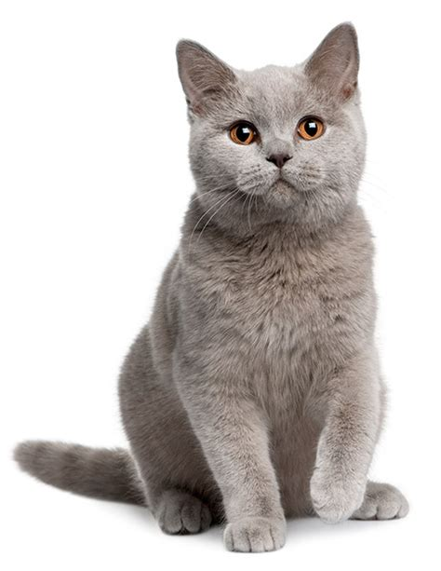

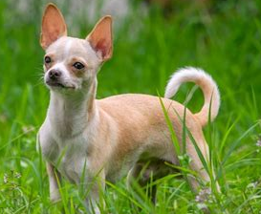
K-means Clustering
Doggo
Gato

Slide 70
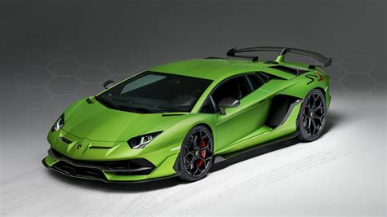



Classes
Class
Instances

